Slide 1
EDA Presentation and
Modeling Technique Proposal
Data Science - Bank Marketing Campaign
Data Glacier - Team Datalux
Asmaa Alqurashi
Deepak Rawat
Huu Thien Nguyen

Slide 2

PROJECT SECTION
Team Introduction
Problem Description
GitHub Repository
EDA Presentation for Business Users
Machine Learning Model Recommendation

Slide 3
Team Introduction
Group Name: Datalux
Group Members: 3
Specialisation: Data Science
Submitted to: Data Glacier canvas platform
Internship Batch: LISUM09
Name | Email | Country | Uni/Company
Huu Thien Nguyen | nguyenhuuthien27296@gmail.com | Sweden | Skövde University
Asmaa Alqurashi | asmaa.idk@gmail.com | Saudi Arabia | Taif University
Deepak Rawat | deepakrawat68@gmail.com | Ireland | Dublin Business School

Slide 4
Problem Description
The ABC Bank wants to market its term deposit product to clients in this project.
A machine learning model that will assist them in determining whether a particular consumer would buy their product.
Goal: Save the time and resources and finally leads to optimised cost for this campaign.

Slide 5

GitHub repository
The link for GitHub: https://github.com/AndrewNguyen27296/DataGlacier

Slide 6
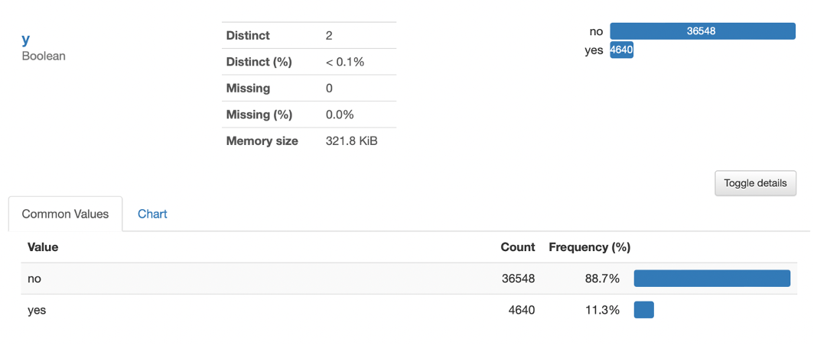
EDA Presentation for Business Users
Insight #1: Sampling techniques and ensemble methods are required when building classification due to an imbalanced dataset.
Imbalance between the dependent variables is 88.7% for refusal (no) and 11.3% for customers who subscribe to a term deposit
Under-, over-, and random selection technique can be applied to solve this problem
The bagging, boosting, and stacking method can improve the ML’s predictive score
The imbalance of dependent variables in the banking dataset

Slide 7
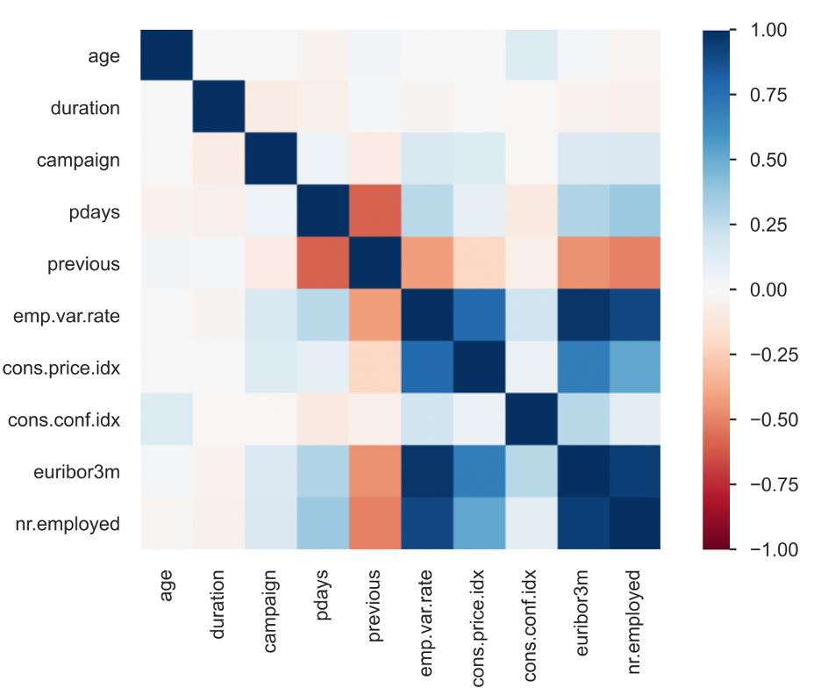
EDA Presentation for Business Users
Insight #2: Feature engineering with highly correlated numeric variables.
pdays feature should be excluded when modelling or re-examining
The distribution is imbalanced; 96,3% is a “999” value, which does not provide any valuable information
It correlated to the “previous” feature and will cause noises
Proposed methods: bin the pdays into two groups, “contacted” and “not contacted”.
“cons.conf.idx”, “euribor3m”, and “nr.employed” can be combined
Correlation matrix of numeric variables in the banking dataset

Slide 8
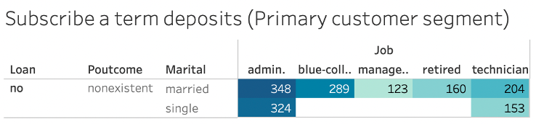
EDA Presentation for Business Users
Insight #3: Deploying marketing campaign on primary client segment (subscribed term deposit customers), which are married/single, non-existent poutcome, and do not have loans.
The segment of customers based on work profession, marriage status, poutcome, and loan history
The filter of subscribers (Y=yes) and count of subscribed cases> 110 was applied
If a client is single, the bank-firm needs to target admin and technicians to maximise the profit. Vice versa, admin, blue-collar, managers, retired, and technicians are the leading group of customers to focus on
Primary customer segment, which needed to focus on the marketing/customer service

Slide 9
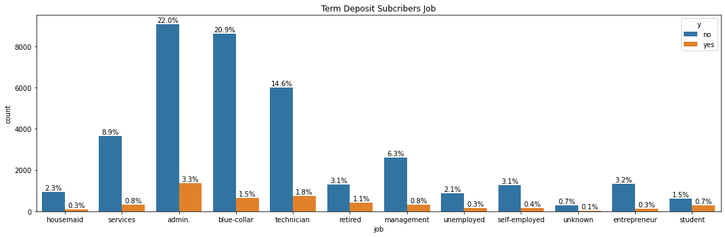
EDA Presentation for Business Users
Insight #4: Profile the clients to target the right group for the campaign.
Jobs: Targeting administer (3.3%) and technician (1.8%) clients. Clints with these jobs are most subscribers to the term deposit.

Slide 10
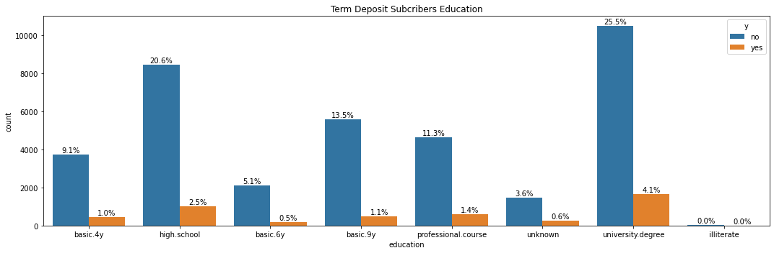
EDA Presentation for Business Users
Insight #4: Profile the clients to target the right group for the campaign.
Education: More subscriber to the term deposit with a university degree (4.1%). We recommend targeting these clints.

Slide 11
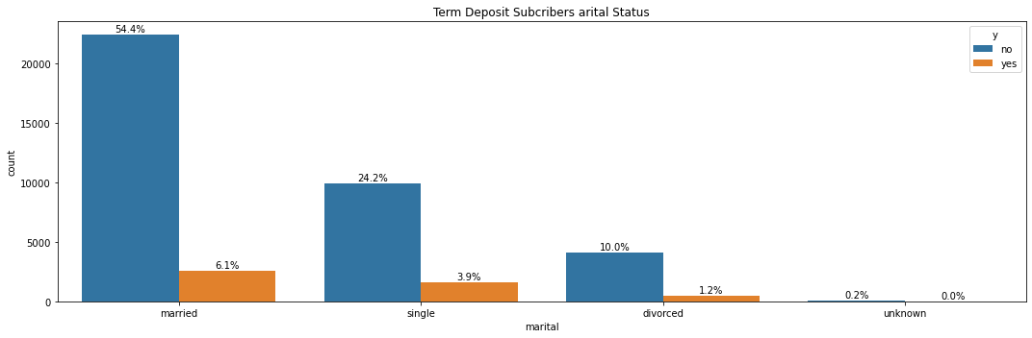
EDA Presentation for Business Users
Insight #4: Profile the clients to target the right group for the campaign.
Marital Status: Most clients are married so the number of the married subscribers (6.1%) is higher but relatively singles (24.2%) are less but subscribed (3.9%) more to the term deposit so it’s a good idea to target both.

Slide 12
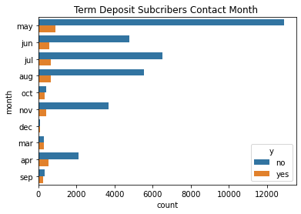
EDA Presentation for Business Users
Insight #5: The month of the contact impacts the response of the clients (most clients subscribed in May), and more calls were made in May. The calls to target the clints shouldn’t be focused only on May but also on October, September and March.

Slide 13
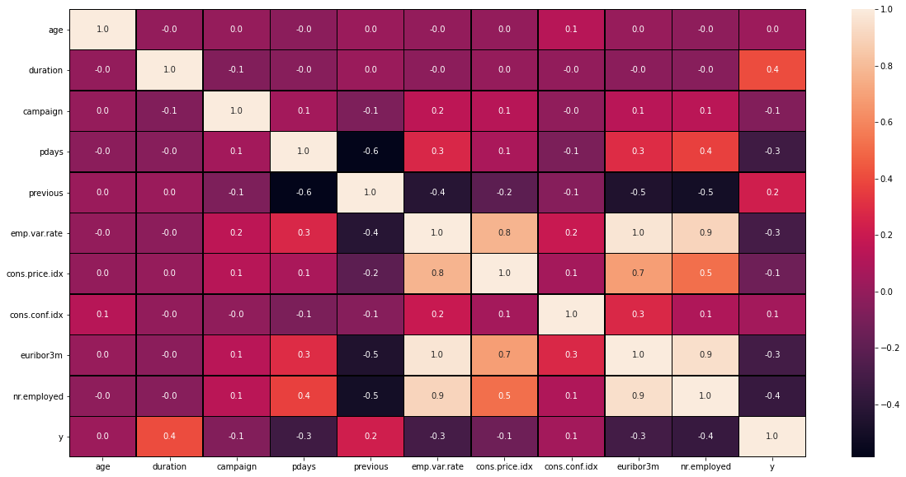
EDA Presentation for Business Users
Insight #6: Increasing the call duration impacts the response to the campaign.
Duration of the call has high correlation with the target which means the longer the call with clients the higher the chance of the client subscribing to the term deposit.

Slide 14
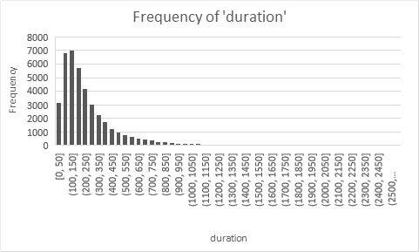
EDA Presentation for Business Users
Insight #7 : The duration of most calls is under 600 seconds (10 minutes). The average call duration is 4 minutes, it is recommended to target the customers to have a call duration of approx 5 minutes.

Slide 15
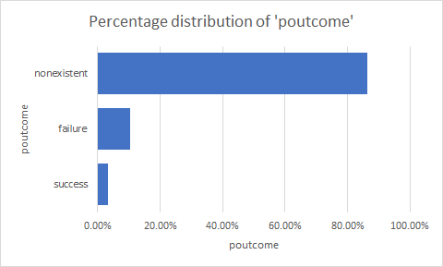
EDA Presentation for Business Users
Insight #8:The outcome of the previous marketing campaign is nonexistent for more than 85%, so we can target these customers for this campaign along with successful customers.

Slide 16
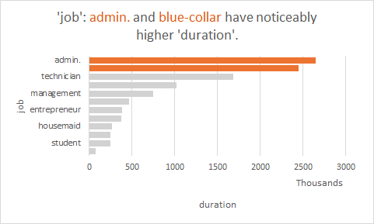
EDA Presentation for Business Users
Insight #9: The total duration of call for admin and blue collar jobs is high as compared to other professions, so they may take more time of callers in the campaign

Slide 17
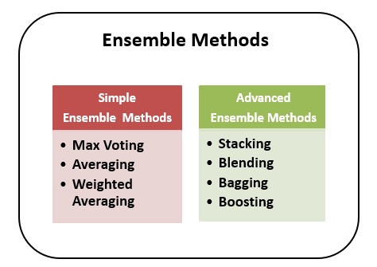
Machine Learning Model Recommendation
Based on Insight #1: Sampling techniques and ensemble methods are required when building classification due to an imbalanced dataset.

Slide 18
Machine Learning Model Recommendation
After Modeling there’s many evaluation methods to choose the best classification model for our problem such as:
Classification accuracy: shows how many of the predictions are correct.
Confusion matrix: it provides insight into the predictions and show the correct and incorrect (i.e. true or false) predictions.
Precision and recall: Precision measures how good our model is when the prediction is positive. Recall measures how good our model is at correctly predicting positive classes.
F1 score: the weighted average of precision and recall

